Slide 1
Lecture 37
Client-Server Application
OR
Communication with Web

Slide 2
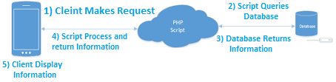
Processing of Client-Server Application

Slide 3
Methods
In Android, If you want to make Client-Server Application then you can use two methods.
Using JSON.
Using HttpClients.
JSON (JavaScript Object Notation) is a lightweight data-interchange format. It is easy for humans to read and write. It is easy for machines to parse and generate. It is based on a subset of the JavaScript Programming Language.
HTTPClient encapsulate the objects required to execute HTTP requests while handling cookies, authentication, connection management, and other features. Thread safety of HTTP clients depends on the implementation and configuration of the specific client.

Slide 4
Client-Server communication using HttpClient
Create HttpClient with the default constructor.
Create a HttpGet or HttpPost object depending upon your needs.
Initialize the object with a GET or POST url.
Execute the GET/POST object through the Http and you’ll get the server’s response in the response object of HttpResponse.
Note:- You have to need of this Permission:
<uses-permission android:name="android.permission.INTERNET />

Slide 5
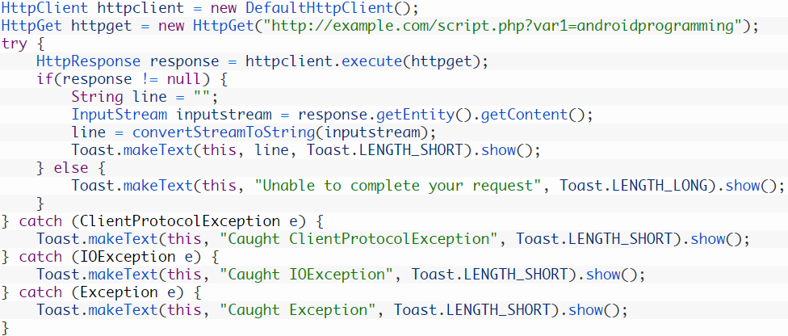
Client-Server communication using HttpClient

Slide 6
JSON
Based on JavaScript object, JSON is a textual representation of complex data instances.
It has 4 basic types:
Strings, Numbers, Boolean, Null.
Note:- Arrays can be constructed where object in terms of JSON is used for key-value pairs.
Note:- You have to need of this Permission:
<uses-permission android:name="android.permission.INTERNET />

Slide 7
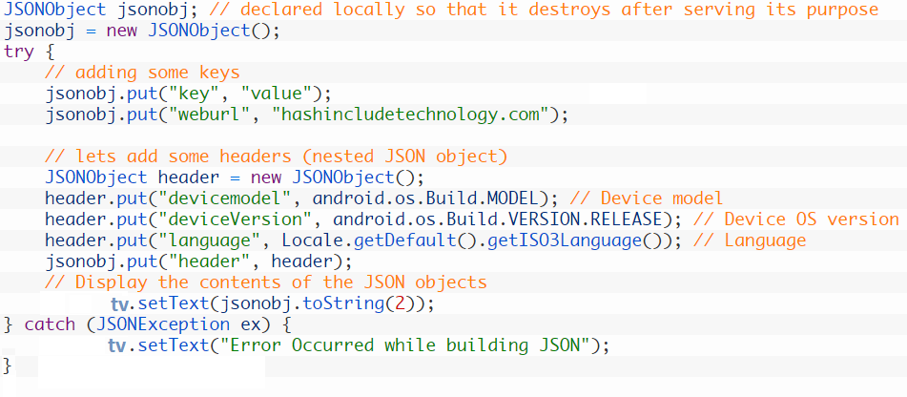
Client-Server communication using JSON

